Slide 1
Compiler Design
23CS5PECPD – Unit 1
Prof. SNEHA S BAGALKOT
Assistant Professor, Dept. of CSE

Slide 2
UNIT – 1: Introduction
Introduction, Lexical Analysis
Language processors
The Structure of Compilers
Lexical analysis
The Role of Lexical Analyzer
Input Buffering
Specifications of Tokens
Recognition of Tokens.

Slide 3
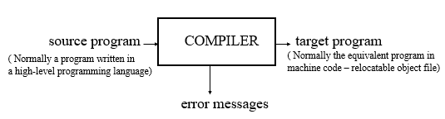
Introduction to COMPILERS
A compiler is a program takes a program written in a source language and translates it into an equivalent program in a target language.

Slide 4
Major Parts of Compilers
There are two major parts of a compiler: Analysis and Synthesis
In analysis phase, an intermediate representation is created from the given source program.
    Lexical Analyzer, Syntax Analyzer and Semantic Analyzer are the parts of this phase.
In synthesis phase, the equivalent target program is created from this intermediate representation.
    Intermediate Code Generator, Code Generator, and Code Optimizer are the parts of this phase.

Slide 5
Phases of A Compiler
Source
Program
Lexical
Analyzer
Syntax
Analyzer
Semantic
Analyzer
Intermediate
Code Generator
Code
Optimizer
Code
Generator
Target
Program
Each phase transforms the source program from one representation into another representation.
They communicate with error handlers.
They communicate with the symbol table.

Slide 6
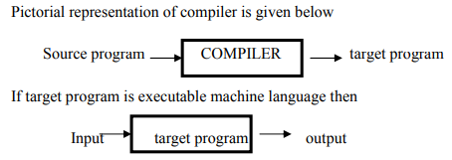
Language processors
Is a software which processes a program given in a certain source language.
Types: Compilers, interpreters, preprocessors, assembler, etc.
Compiler

Slide 7

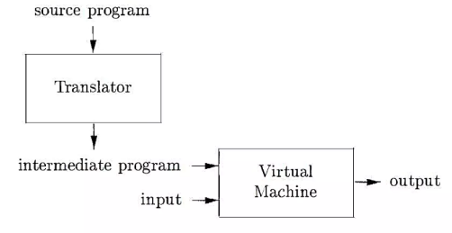
Language processors contd.
Interpreter
Hybrid Compiler

Slide 8
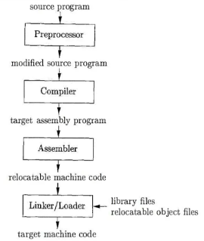
Language-processing system

Slide 9
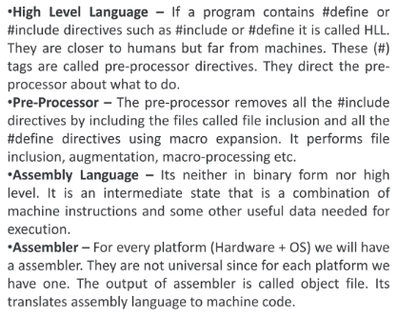

Slide 10
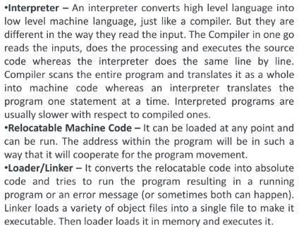

Slide 11
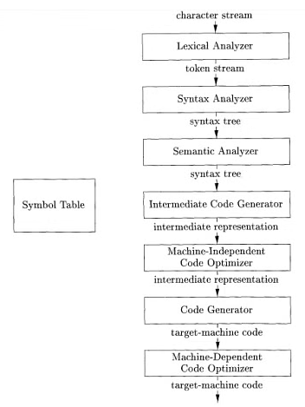
The Structure of Compilers
Phases of a Compiler

Slide 12
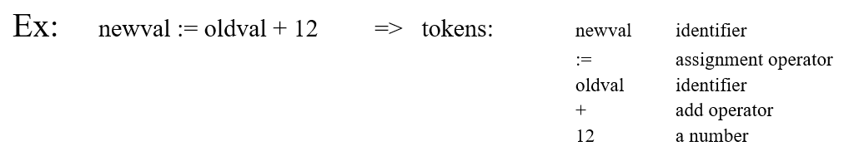
Lexical Analysis
The first phase of a compiler is called lexical analysis or scanning.
Lexical Analyzer reads the source program character by character and returns the tokens of the source program.
A token describes a pattern of characters having same meaning in the source program. (such as identifiers, operators, keywords, numbers, delimiters and so on)

Slide 13
Lexical Analyzer
Puts information about identifiers into the symbol table.
Regular expressions are used to describe tokens (lexical constructs).
A (Deterministic) Finite State Automaton can be used in the implementation of a lexical analyzer.

Slide 14
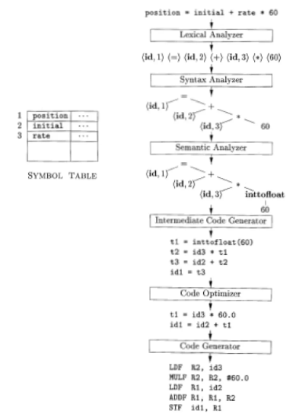
Translation of an assignment statement

Slide 15
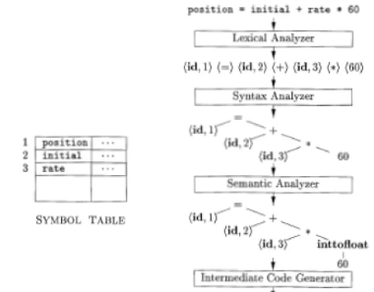

Slide 16
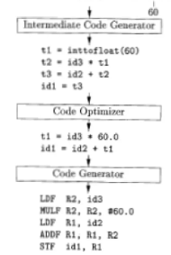

Slide 17
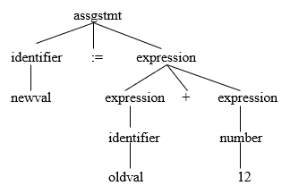
Syntax Analysis
A Syntax Analyzer creates the syntactic structure (generally a parse tree) of the given program.
A syntax analyzer is also called as a parser.
A parse tree describes a syntactic structure.
Ex: newval = oldval + 12
In a parse tree, all terminals are at leaves.
All inner nodes are non-terminals in a context free grammar.

Slide 18
Syntax Analyzer (CFG)
The syntax of a language is specified by a context free grammar (CFG).
The rules in a CFG are mostly recursive.
A syntax analyzer checks whether a given program satisfies the rules implied by a CFG or not.
  If it satisfies, the syntax analyzer creates a parse tree for the given program.
Ex: We use BNF (Backus Naur Form) to specify a CFG
assignstmt -> identifier := expression
expression -> identifier
expression -> number
expression -> expression + expression

Slide 19
Syntax Analyzer versus Lexical Analyzer
Which constructs of a program should be recognized by the lexical analyzer, and which ones by the syntax analyzer?
    Both of them do similar things; But the lexical analyzer deals with simple non-recursive constructs of the language.
    The syntax analyzer deals with recursive constructs of the language.

Slide 20
Syntax Analyzer versus Lexical Analyzer
Which constructs of a program should be recognized by the lexical analyzer, and which ones by the syntax analyzer?
    The lexical analyzer simplifies the job of the syntax analyzer.
    The lexical analyzer recognizes the smallest meaningful units (tokens) in a source program.
    The syntax analyzer works on the smallest meaningful units (tokens) in a source program to recognize meaningful structures in our programming language.

Slide 21
Parsing Techniques
Depending on how the parse tree is created, there are different parsing techniques.
These parsing techniques are categorized into two groups:
    Top-Down Parsing,
    Bottom-Up Parsing
Top-Down Parsing:
    Construction of the parse tree starts at the root, and proceeds towards the leaves.
    Efficient top-down parsers can be easily constructed by hand.
    Recursive Predictive Parsing, Non-Recursive Predictive Parsing (LL Parsing).

Slide 22
Parsing Techniques
Bottom-Up Parsing:
    Construction of the parse tree starts at the leaves, and proceeds towards the root.
    Normally efficient bottom-up parsers are created with the help of some software tools.
    Bottom-up parsing is also known as shift-reduce parsing.
    Operator-Precedence Parsing – simple, restrictive, easy to implement
    LR Parsing – much general form of shift-reduce parsing, LR, SLR, LALR

Slide 23
Semantic Analyzer
A semantic analyzer checks the source program for semantic errors and collects the type information for the code generation.
Type-checking is an important part of semantic analyzer.
Normally semantic information cannot be represented by a context-free language used in syntax analyzers.
Context-free grammars used in the syntax analysis are integrated with attributes (semantic rules)
    the result is a syntax-directed translation,
    Attribute grammars
Ex:
  newval := oldval + 12
      The type of the identifier newval must match with type of the expression (oldval+12)

Slide 24
Intermediate Code Generation
A compiler may produce an explicit intermediate codes representing the source program.
These intermediate codes are generally machine (architecture independent). But the level of intermediate codes is close to the level of machine codes.
Ex:
  newval := oldval * fact + 1
  id1 := id2 * id3 + 1
  MULT id2,id3,temp1 Intermediates Codes (Quadruples)
  ADD temp1,#1,temp2
  MOV temp2,,id1

Slide 25
Code Optimizer (for Intermediate Code Generator)
The code optimizer optimizes the code produced by the intermediate code generator in the terms of time and space.
Ex:
  MULT id2,id3,temp1
  ADD temp1,#1,id1

Slide 26
Code Generator
Produces the target language in a specific architecture.
The target program is normally is a relocatable object file containing the machine codes.
Ex:
( assume that we have an architecture with instructions whose at least one of its operands is a machine register)
  MOVE id2, R1
  MULT id3, R1
  ADD #1, R1
  MOVE R1, id1

Slide 27
Symbol-Table Management
An essential function of a compiler is to record the variable names used in the source program and collect information about various attributes of each name..
The symbol table is a data structure containing a record for each variable name, with fields for the attributes of the name.

Slide 28
The Grouping of Phases into Passes
The discussion of phases deals with the logical organization of a compiler.
In an implementation, activities from several phases may be grouped together into a pass that reads an input file and writes an output file.
For example, the front-end phases of lexical analysis, syntax analysis, semantic analysis, and intermediate code generation might be grouped together into one pass.
Code optimization might be an optional pass.
Then there could be a back-end pass consisting of code generation for a particular target machine.

Slide 29
Compiler-Construction Tools
The compiler writer, like any software developer, can profitably use modern software development environments containing tools such as language editors, debuggers, version managers, profilers, test harnesses, and so on.
These tools use specialized languages for specifying and implementing specific components, and many use quite sophisticated algorithms.

Slide 30
Compiler-Construction Tools
1. Parser generators that automatically produce syntax analyzers from a grammatical description of a programming language.
2. Scanner generators that produce lexical analyzers from a regular-expression description of the tokens of a language.
3. Syntax-directed translation engines that produce collections of routines for walking a parse tree and generating intermediate code.

Slide 31
Compiler-Construction Tools
4. Code-generator generators that produce a code generator from a collection of rules for translating each operation of the intermediate language into the machine language for a target machine.
5. Data-flow analysis engines that facilitate the gathering of information about how values are transmitted from one part of a program to each other part. Data-flow analysis is a key part of code optimization.
6. Compiler-construction toolkits that provide an integrated set of routines for constructing various phases of a compiler.

Slide 32
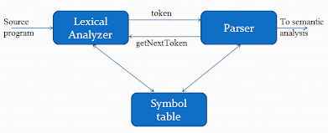
Lexical Analysis: The Role of Lexical Analyzer
Interactions between the lexical analyzer and the parser

Slide 33
Lexical Analyzer
Lexical analyzers are divided into a cascade of two processes:
  a) Scanning consists of the simple processes that do not require tokenization of the input, such as deletion of comments and compaction of consecutive whitespace characters into one.
  b) Lexical analysis proper is the more complex portion, where the scanner produces the sequence of tokens as output.

Slide 34
Lexical Analysis Versus Parsing
There are a number of reasons why the analysis portion of a compiler is normally separated into lexical analysis and parsing (syntax analysis) phases.:
  Simplicity of design is the most important consideration.
  Compiler efficiency is improved.
  Compiler portability is enhanced.

Slide 35
Tokens, Patterns, and Lexemes
A token is a pair consisting of a token name and an optional attribute value.
The token name is an abstract symbol representing a kind of lexical unit, e.g., a particular keyword, or a sequence of input characters denoting an identifier.
The token names are the input symbols that the parser processes.
We will often refer to a token by its token name.

Slide 36
Tokens, Patterns, and Lexemes
A pattern is a description of the form that the lexemes of a token may take.
In the case of a keyword as a token, the pattern is just the sequence of characters that form the keyword.
For identifiers and some other tokens, the pattern is a more complex structure that is matched by many strings.

Slide 37
Lexical Analysis Versus Parsing
A lexeme is a sequence of characters in the source program that matches the pattern for a token and is identified by the lexical analyzer as an instance of that token.

Slide 38
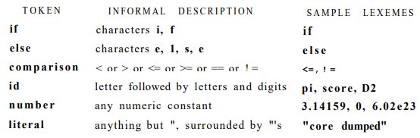
Examples of tokens

Slide 39
Tokens
These classes cover most or all of the tokens:
1. One token for each keyword. The pattern for a keyword is the same as the keyword itself.
2. Tokens for the operators, either individually or in classes such as the token comparison.
3. One token representing all identifiers.
4. One or more tokens representing constants, such as numbers and literal
5. Tokens for each punctuation symbol, such as left and right parentheses, comma, and semicolon.

Slide 40

Example:

Slide 41
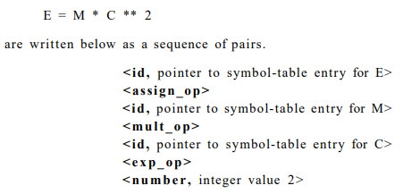
Attributes for Tokens

Slide 42

Lexical Errors
It is hard for a lexical analyzer to tell, without the aid of other components, that there is a source-code error.
For instance, if the string “fi” is encountered for the first time in a C program in the context:
A lexical analyzer cannot tell whether fi is a misspelling of the keyword if or an undeclared function identifier.

Slide 43
Other possible error-recovery actions are:
  1. Delete one character from the remaining input.
  2. Insert a missing character into the remaining input.
  3. Replace a character by another character.
  4. Transpose two adjacent characters.

Slide 44
Input Buffering
To recognize tokens reading data/source program from hard disk is done.
Accessing hard disk each time is time consuming, so special buffer techniques have been developed to reduce the amount of overhead required.

Slide 45
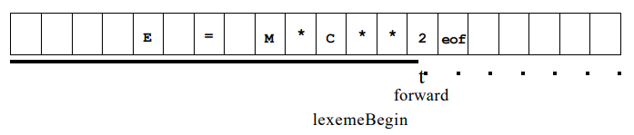
Buffer Pairs
Two pointers to the input are maintained:
1. Pointer lexemeBegin, marks the beginning of the current lexeme, whose extent we are attempting to determine.
2. Pointer forward scans ahead until a pattern match is found; the exact strategy whereby this determination is made

Slide 46
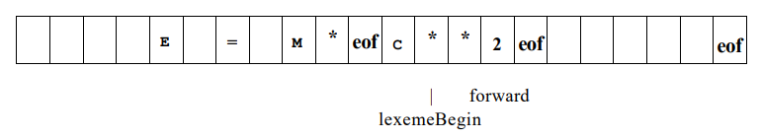
Sentinels
Sentinel is a special character that cannot be a part of source program, eof is used as sentinel.
Sentinels at the end of each buffer

Slide 47
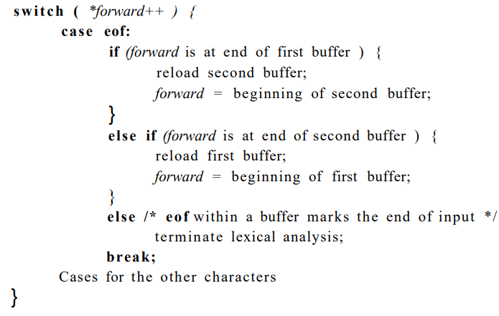
Lookahead code with Sentinels

Slide 48
Specifications of Tokens
Regular expressions are an important notation for specifying lexeme patterns.
Terminologies and formal notations used:
  Strings and Languages
  Operations on Languages
  Regular Expressions
  Regular Definitions
  Extensions of Regular expressions

Slide 49
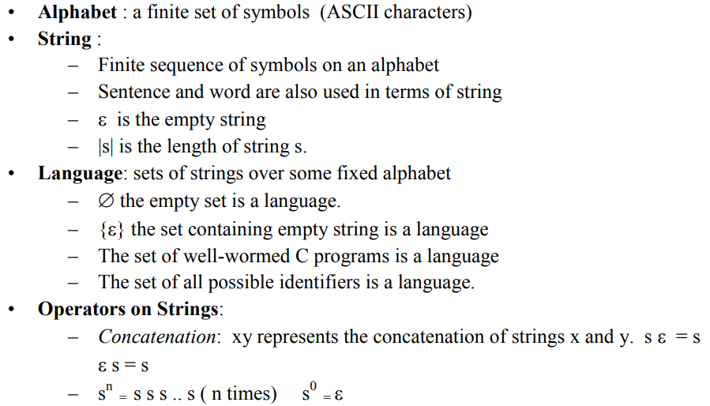

Slide 50
Terms for Parts of Strings
1. A prefix of string s is any string obtained by removing zero or more symbols from the end of s. For example, ban, banana, and e are prefixes of banana.
2. A suffix of string s is any string obtained by removing zero or more symbols from the beginning of s. For example, nana, banana, and e are suffixes of banana.
3. A substring of s is obtained by deleting any prefix and any suffix from s. For instance, banana, nan, and e are substrings of banana.
4. The proper prefixes, suffixes, and substrings of a string s are those, prefixes, suffixes, and substrings, respectively, of s that are not e or not equal to s itself.
5. A subsequence of s is any string formed by deleting zero or more not necessarily consecutive positions of s. For example, baan is a subsequence of banana.

Slide 51
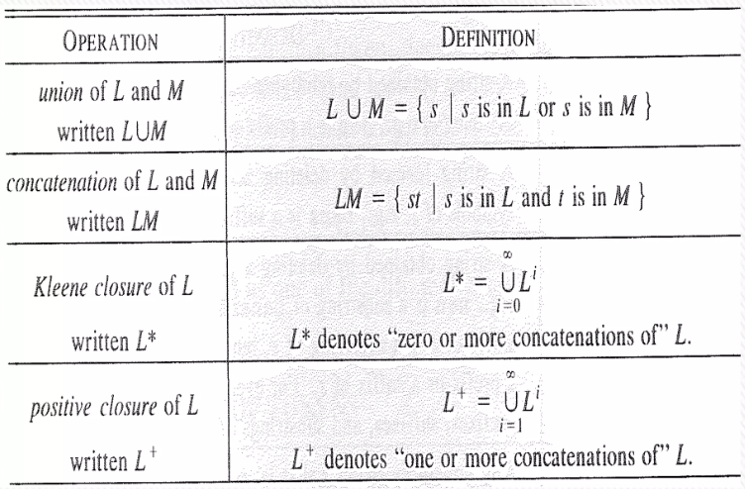
Operations on Languages
Definitions of operations on languages

Slide 52
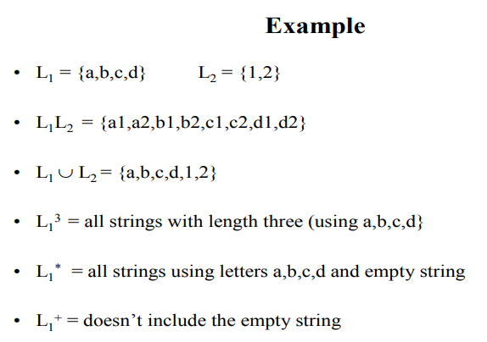

Slide 53
Example
L is set of letters {A, B,.. . , Z, a, b,... , z}; D is set of digits {0,1,.. . 9}
1. L U D is the set of letters and digits — strictly speaking the language with 62 strings of length one, each of which strings is either one letter or one digit.
2. LD is the set of 520 strings of length two, each consisting of one letter followed by one digit.
3. L4 is the set of all 4-letter strings.
4. L* is the set of all strings of letters, including ε, the empty string.
5. L(L U D)* is the set of all strings of letters and digits beginning with a letter.
6. D+ is the set of all strings of one or more digits.

Slide 54

Regular Expressions
To describe the set of valid C identifiers
If letter- is established to stand for any letter or the underscore
digit- is established to stand for any digit, then we could describe the language of C identifiers by:

Slide 55
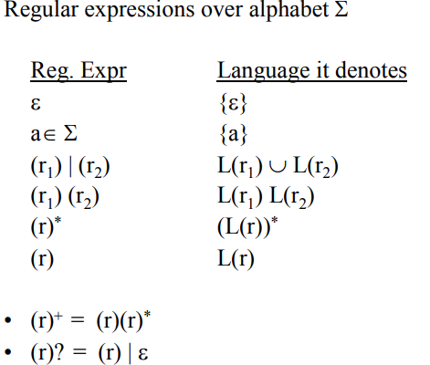

Slide 56
Regular Expressions
BASIS: There are two rules that form the basis:
1. ε is a regular expression, and L(ε) is {ε}, that is, the language whose sole member is the empty string.
2. If a is a symbol in Σ, then a is a regular expression, and L(a) = {a}, that is, the language with one string, of length one, with a in its one position.

Slide 57
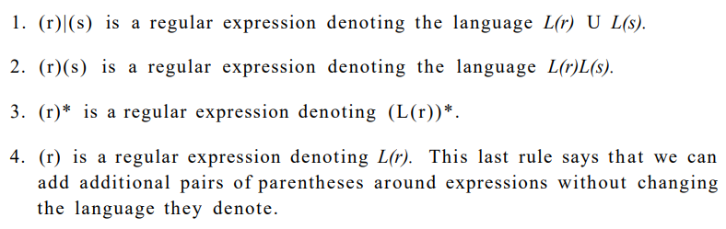
INDUCTION
There are four parts to the induction whereby larger regular expressions are built from smaller ones.
Suppose r and s are regular expressions denoting languages L(r) and L(s), respectively.

Slide 58


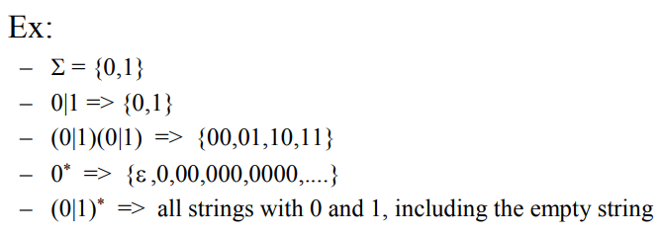
Precedence

Slide 59
Example:
Let Σ = {a, b}
1. The regular expression a|b denotes the language {a, b}.
2. (a|b)(a|b) denotes {aa, ab, ba, bb}, the language of all strings of length two over the alphabet Σ. Another regular expression for the same language is aa|ab|ba|bb.
3. a* denotes the language consisting of all strings of zero or more a's, that is, {ε, a, aa, aaa,...} .
4. (a|b)* denotes the set of all strings consisting of zero or more instances of a or b, that is, all strings of a's and b's: {e, a, b, aa, ab, ba, bb, aaa,...}. Another regular expression for the same language is (a*b*)*.
5. a|a*b denotes the language {a, b, ab, aab, aaab,...}, that is, the string a and all strings consisting of zero or more a's and ending in b.

Slide 60
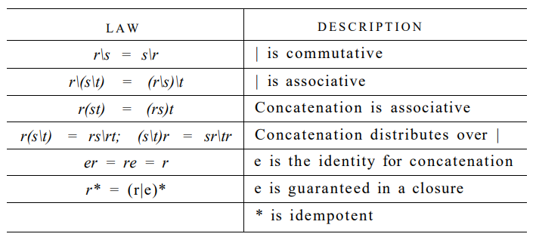
Algebraic laws for regular expressions
(r*)* = r*

Slide 61
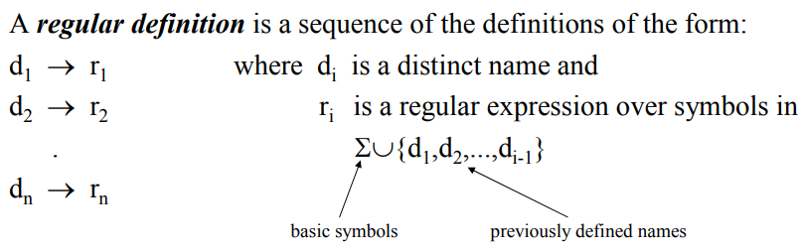
Regular Definitions
To write regular expression for some languages can be difficult, because their regular expressions can be quite complex.
In those cases, we may use regular definitions.
We can give names to regular expressions, and these names can be used as symbols to define other regular expressions.

Slide 62
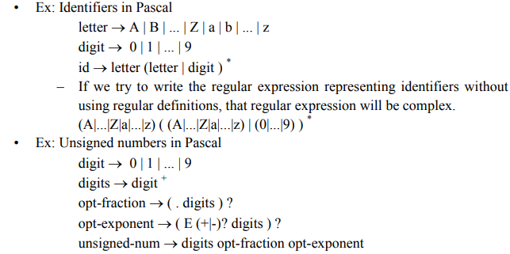

Slide 63
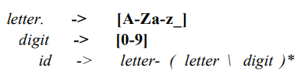
Extensions of Regular Expressions
[abc] is shorthand for a|b|c, and [a-z] is shorthand for a|b|.--|z
Using these shorthands, we can rewrite the regular definition of previous example as:

Slide 64
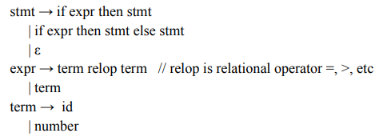
Recognition of Tokens
A grammar for branching statements

Slide 65
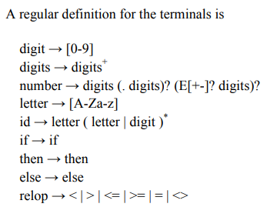

Slide 66
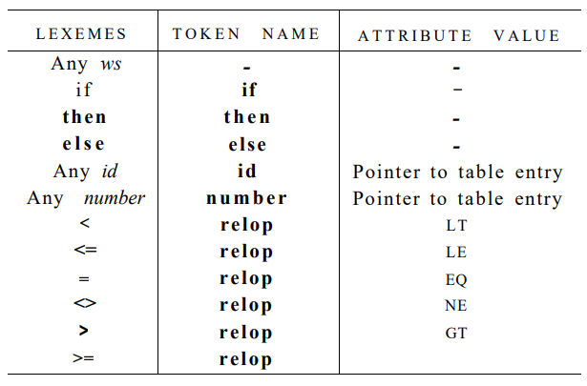
Tokens, their patterns, and attribute values

Slide 67
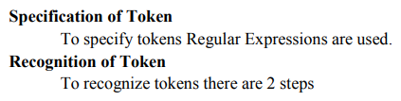


Slide 68
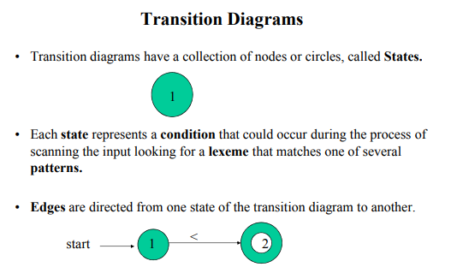

Slide 69
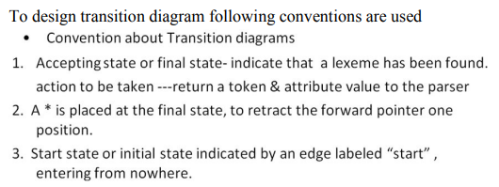

Slide 70
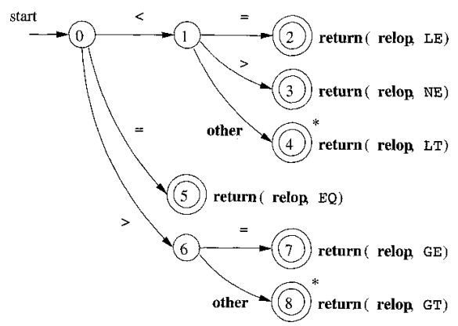
Transition diagram for relop

Slide 71
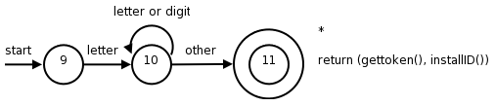
Recognition of Reserved Words and Identifiers
A transition diagram for id's and keywords

Slide 72

Hypothetical transition diagram for the keyword then

Slide 73
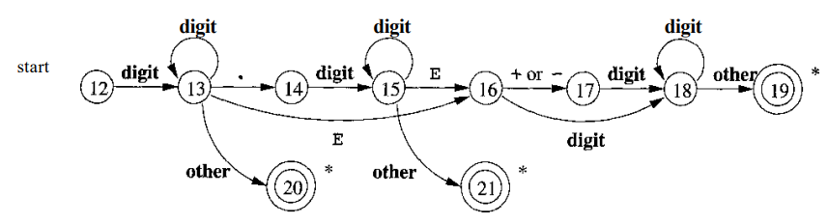
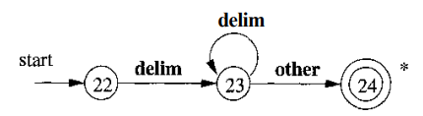
Completion of the Running Example
A transition diagram for unsigned numbers
A transition diagram for whitespace

Slide 74
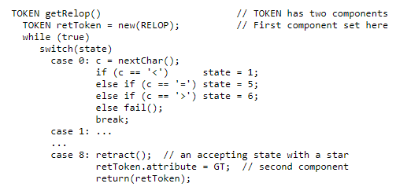
Architecture of a Transition-Diagram-Based Lexical Analyzer
Sketch of implementation of relop transition diagram

Slide 75
Questions:
Implement the transition diagram for identifier.
Sketch the code of transition diagram for unsigned numbers.

Slide 76
THANK
YOU

